Slide 1
Spherical Gear Prototype
For Office-Sized Robotic Arms
Designed and Fabricated by Dang Le

Slide 2
Advantages vs. Disadvantages

Slide 3
Advantages
Compact
Lightweight
Stationary Stepper Motors
Less Moving Wires
Applicable to small projects

Slide 4
Disadvantages
360° - 90° instead of 360°²: So?
Shoulder arm rarely drop below 70°, as gravitational torque becomes significant after 45°
Cannot be used in industry: Solutions
Spherical teeth will crack and degrade at high loads as they are in contact with the enclosure
Development of a spherical "bed mesh" would be needed to fully support this gear
Most office-size robotics are not handling high loads and spherical gears have a competitive edge against conventional gears.

Slide 5
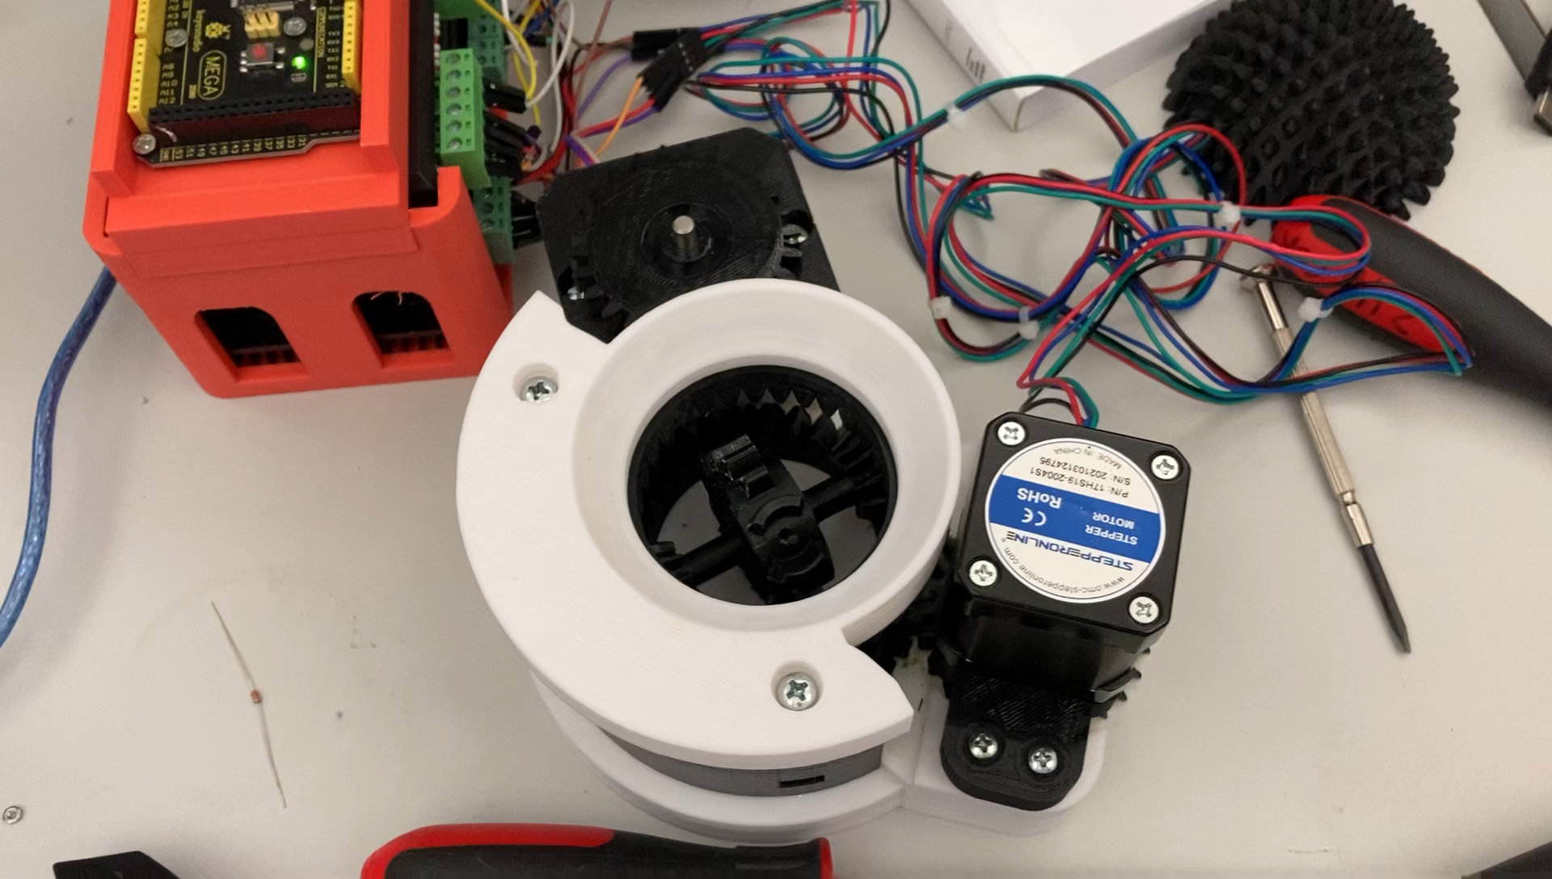
Demo
Proof of concept

Slide 6

CAD Design

Slide 7
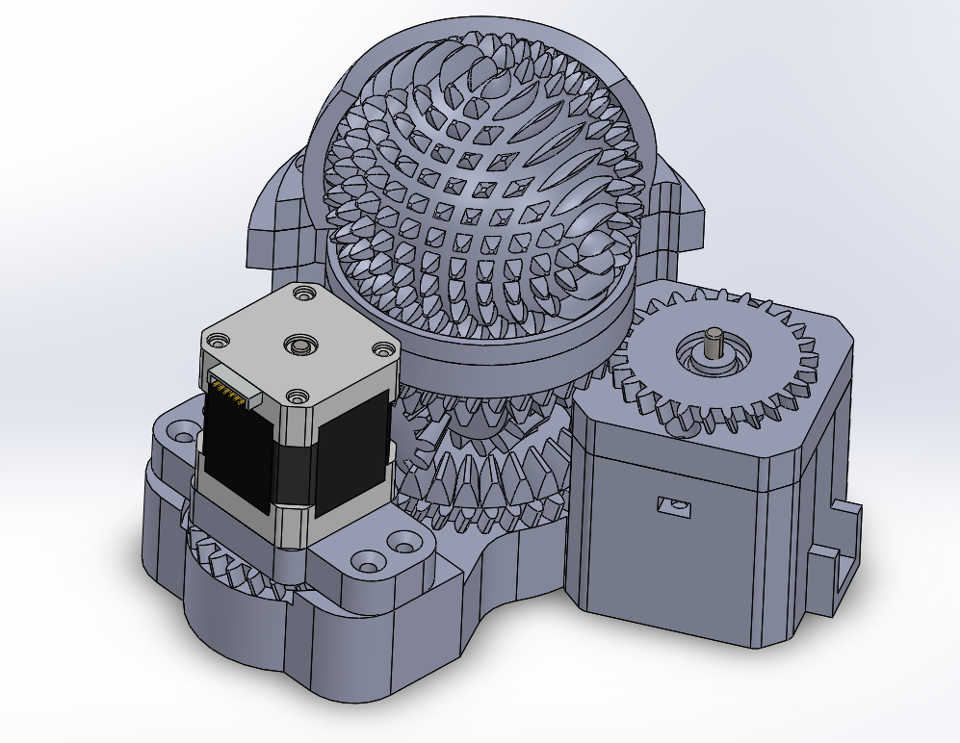

Slide 8
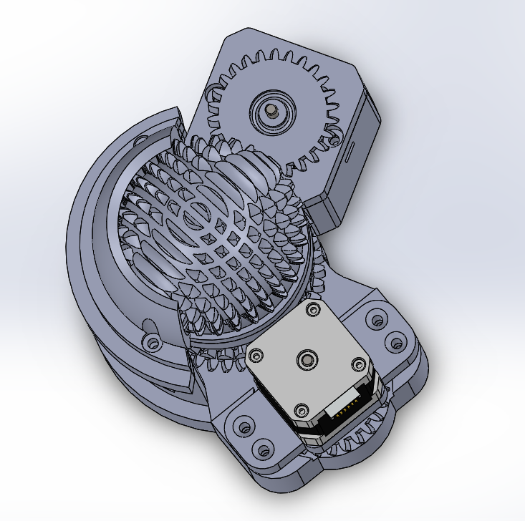

Slide 9
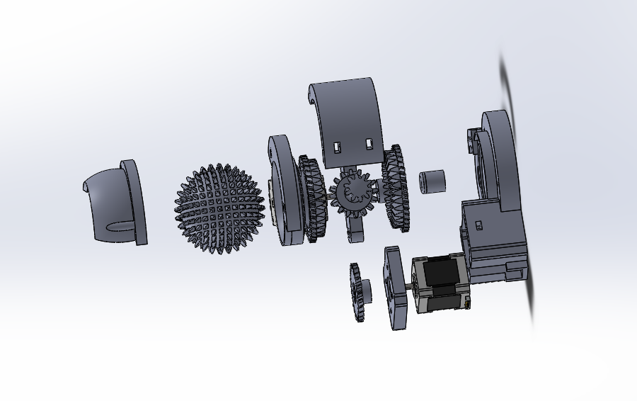

Slide 10
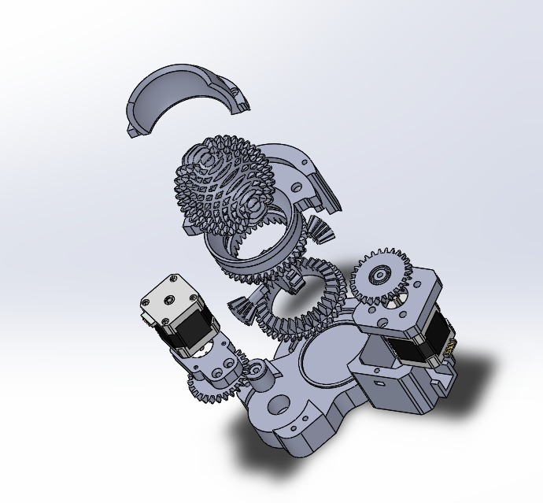

Slide 11
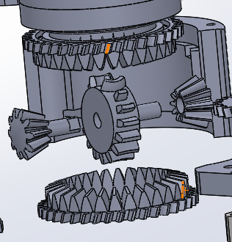

Slide 12
C Language Program

Slide 13
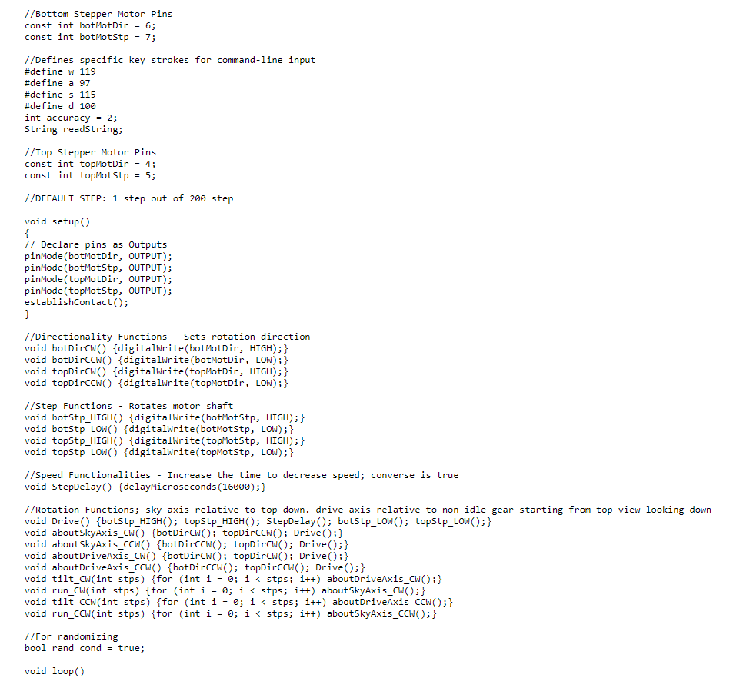
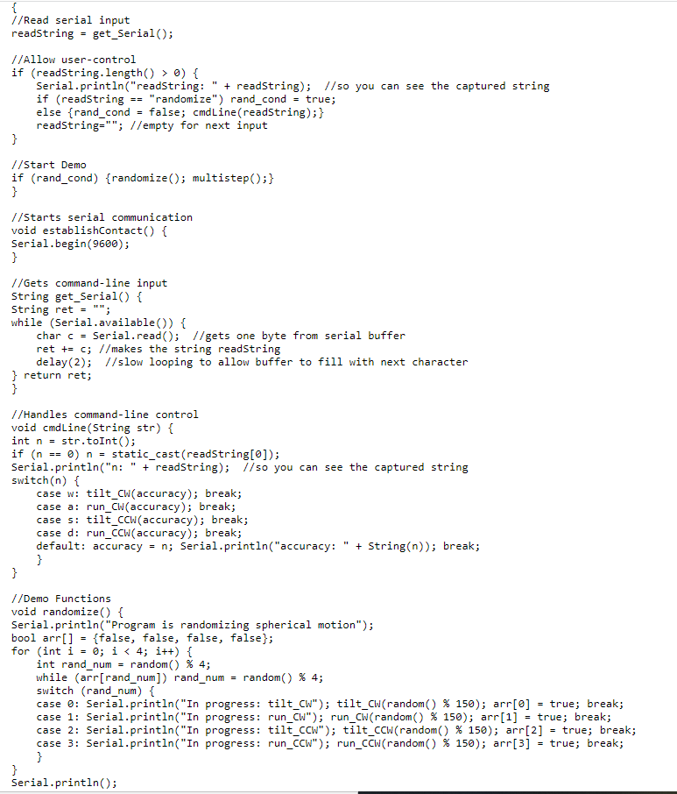
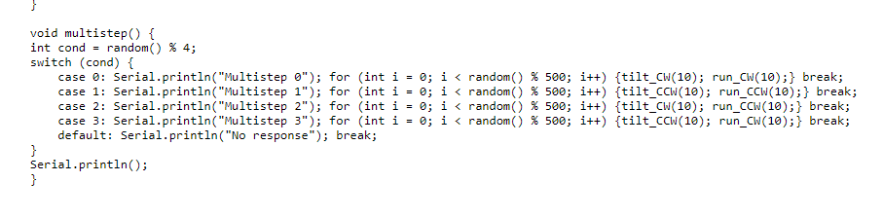

Slide 14
Design Process
Wanted to make robotic arms for office work and automate tedious tasks
Saw research video online and wanted to make a more compact version
Began designing for one month
Attempted to fix my awful 3D printer at home. Gave up after one month and decided to use school's printer
Assembled parts and wrote software

Slide 15
Improvements
Better sphere enclosure
Improve gear mesh between spherical and drive gear
Install gyroscope into spherical for position tracking
Will allow automatic calibration and initialize spherical gear position

Slide 16
Future Applications
Implement this design in future robotic
Design more compact spherical gear apparatus
Improve rigidity and reduce spherical gear vibration and sudden jerks

